Slide 1

LaunchCode Liftoff
Class 7
Kevin Beashore
1/27/2022

Slide 2
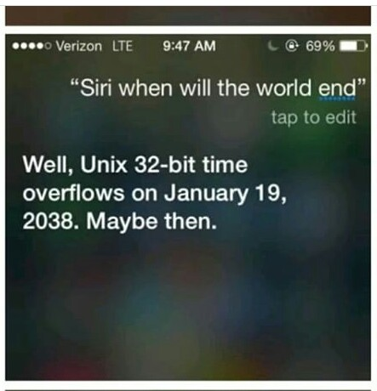
Agenda
Lecture
Refresh on interviewing
Portfolio mention
Coding challenge
Assignment - Project Presentation
Q&A
Activity
Paired Interview Practice
Open Work Time

Slide 3
Liftoff Project Timeline
Address Feedback
Next Features
Behavioral Interviews
Class 5
Class 7
Class 6
Class 8
Next Features
Final Review
Notes:
Resume Aug 21st

Slide 4
Announcements
Last Class
February 3rd
Assignments Due
February 10th

Slide 5
The End is Near!
Required:
Project Outline
Project Planning Assignment
Project (Repository) Setup
Online Profiles
Final Project Review
Live Coding Exercise
Mock Interview Exercise
Project Presentation
LiftOff Ready for placement Survey
LaunchCode Resume
If you are missing any of the assignments, submit them in canvas and let your TA/TF know
If you are missing any of the in-class exercises, reach out to your TA/TF or John to schedule time to meet
All assignments are due February 10th

Slide 6
Behavioral Interview - Refresh

Slide 7

Behavioral Interview
“Describe a Time…” questions
Focus on the Positives and Resolutions
Draw on Non-Work Experiences
Prepare by Identifying Accomplishments & Challenges
Looking for
Team Player
Problem Solver
Resolve Conflicts
Time Management

Slide 8

Claim Evidence Model
Claim - One or Two Sentence Answer
Gets to the Answer
Evidence - Provide Scenario as Evidence
Proves the Answer
Also known as the STAR (Situation, Task
Action & Result
Notes:
Mostly behavioral, but also technical

Slide 9

Behavioral Interviews - Next Week Now
Paired with Interviewer
Mostly Behavioral
Be Prepared to About Your Project
Assignment
Assess Placement Readiness

Slide 10
Building a Portfolio

Slide 11

Why Build a Portfolio
Like an Artist’s Portfolio
Easy to Share Your Work
Potential Employers and Recruiters
Tonight’s Assignment

Slide 12
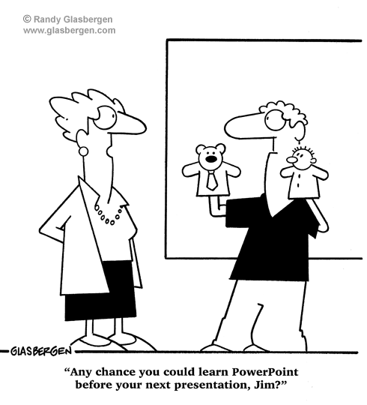
Assignment - Project Presentation
Assignment
Create a Slide Deck Presentation
Overview of Your Project
Technology Stack
Features
Accomplished to Date
Goal: Prepare You for Interview

Slide 13
Objectives
How to talk about your project
Parts of an interview
What you may encounter in a technical interview
How to answer technical questions
What to do if you don’t know how to answer
Using project and class experiences for technical questions
Notes:
How to talk about the project – Elevator pitch, technologies, tools, utilities…..what did you do? What did you help others with?
Parts of an interviews – Recall Phone call, Technical Interview, Behavioral Interview. The Tech or Behavior could be in multiple interviews or the same longer interview.
What you may encounter in a technical interview?
Got to be able to explain it in a technical way to show employers you truly understand the project.
What do to if you don’t know the the answer be truthful and say IDK I believe it might be blah

Slide 14
Q&A?

